Slide 1

Share market
Group number : 6
Group leader : anita mahato
Group member: Mrunal Dushane
Sneha ovhal
Avinash Badigar
Shweta biswal
guided by : veena keshavalu

Slide 2
Business Requirements
USER :
User can buy or sell shares of symbols.
Users will get report of his trades.
BROKER :
Broker can add new entities.
Broker will have access to every entity under his ownership.
Broker can generate his report and report will contain number of shares of particular symbol and exchange.

Slide 3

Assumption
In our system we require the details of the entity ( personal details and bank details) from which broker will get to know margin of the entity.
➢ One user is having one account.
➢ User can buy multiple share and even purchase multiple share.
➢ Broker will access all the users account.

Slide 4
Limitations
Broker will limit the number of trades for entity to buy or sell.
One broker cannot have the access to another broker’s account for security point of views.

Slide 5
Technical specification
COMPONENT NAME | TYPE
P04AP05 | CICS (COBOL)
P04AP06 | CICS (COBOL)
P04AP07 | CICS (COBOL)
P04AP08 | CICS (COBOL)
P04AP09 | CICS (COBOL)
P04AP10 | CICS (COBOL)

Slide 6
TYPE | TOTAL
CICS | 6
COBOL | 6
JCL | 4
KSDS | 3
TOTAL NUMBER OF FILES | 19
FILE NAME | MODE | TYPE
VSAM | INPUT/OUTPUT | KSDS
COBOL | INPUT/OUTPUT | COBOL
CICS | INPUT/OUTPUT | CICS

Slide 7
Validations
1. | LOGIN ID | Login ID must be non-zero.
 |  | Login ID must not have spaces.
 |  | Login ID must not contain characters.
2. | PASSWORD | Password must be alphanumeric.
3. | NAME | Name should be characters only.
4. | CONTACT NO. | It’s length must be 10 digits only.
 |  | It must be only numeric only.
5. | ADDRESS | Length must be 3 only.
 |  | It should only be 3 characters only.
 |  | It should not be numbers or spaces.
6. | Date of Birth | It should be numeric.
 |  | It should be in the format of MM/DD/CCYY.
7. | Earning & Deduction | Must be zonal decimal.
 |  | Deduction must be less than earning.
 |  | Must be numeric.
8. | Login ID doesn’t exist | It will be taken to create entity ID page or broker page accordingly.

Slide 8
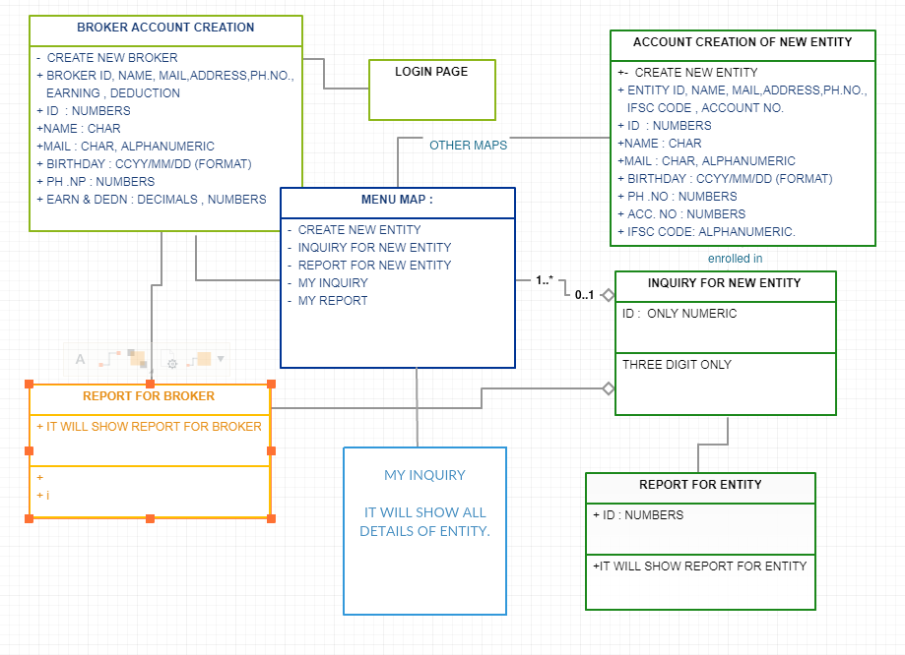
Flow diagram

Slide 9
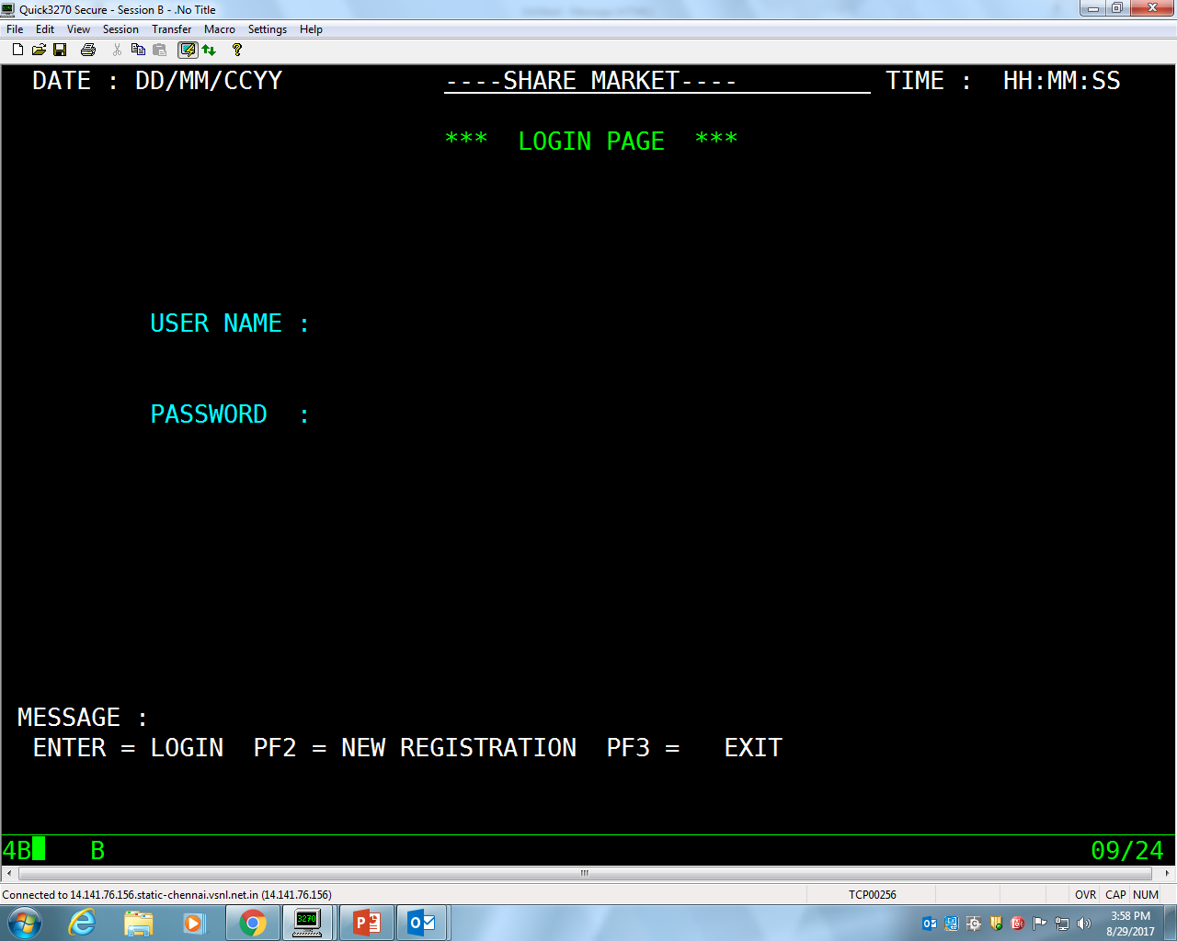
1. Login page

Slide 10
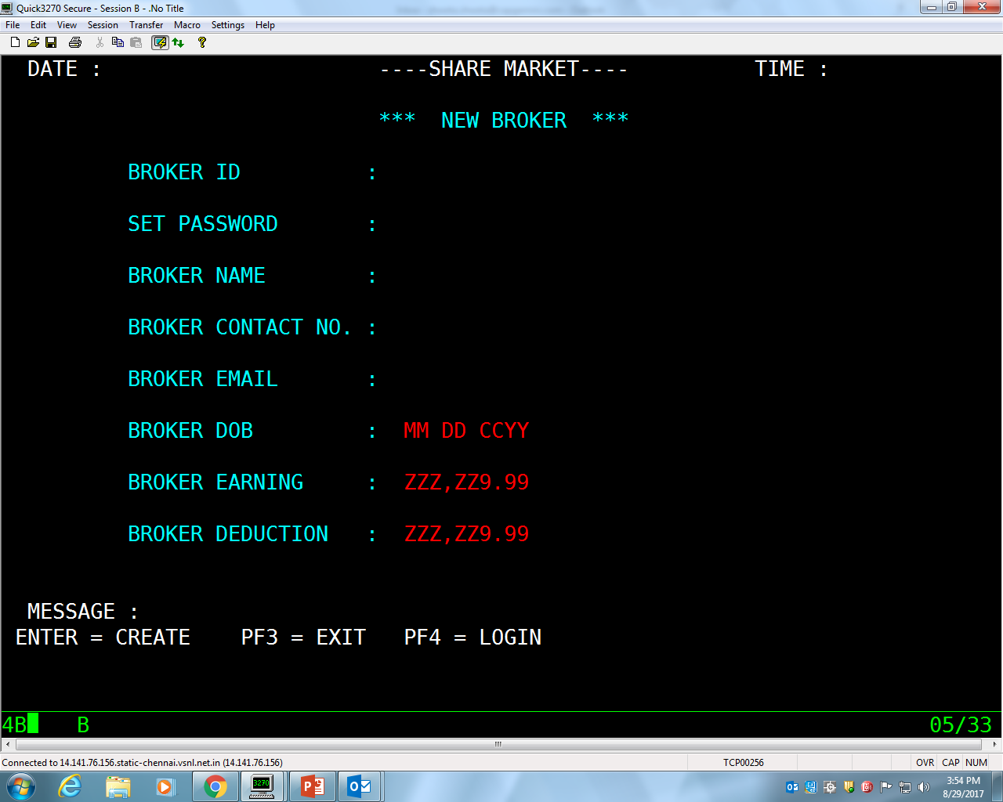
2. Broker account creation

Slide 11
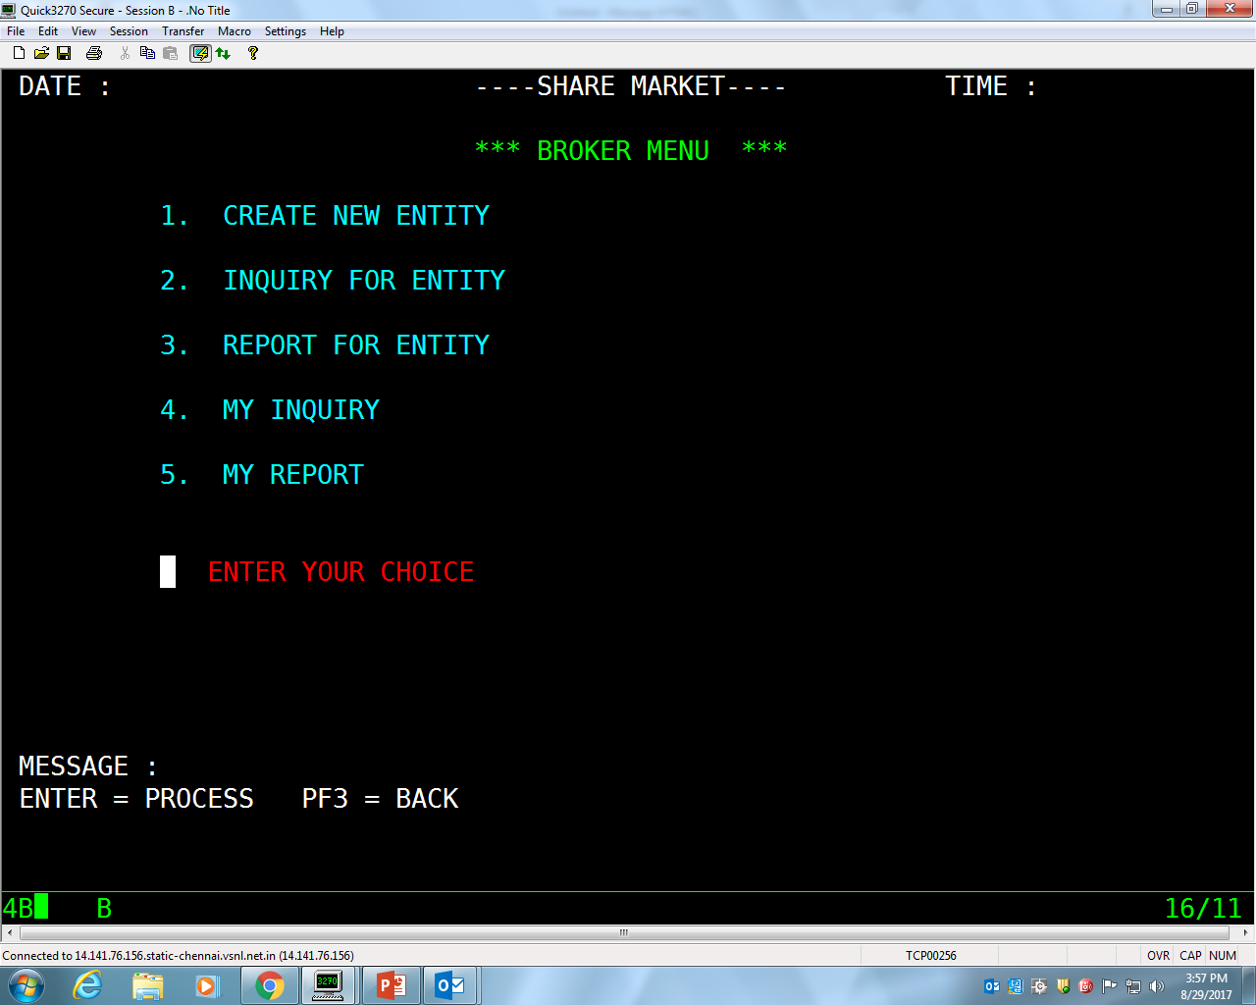
3. Menu map

Slide 12
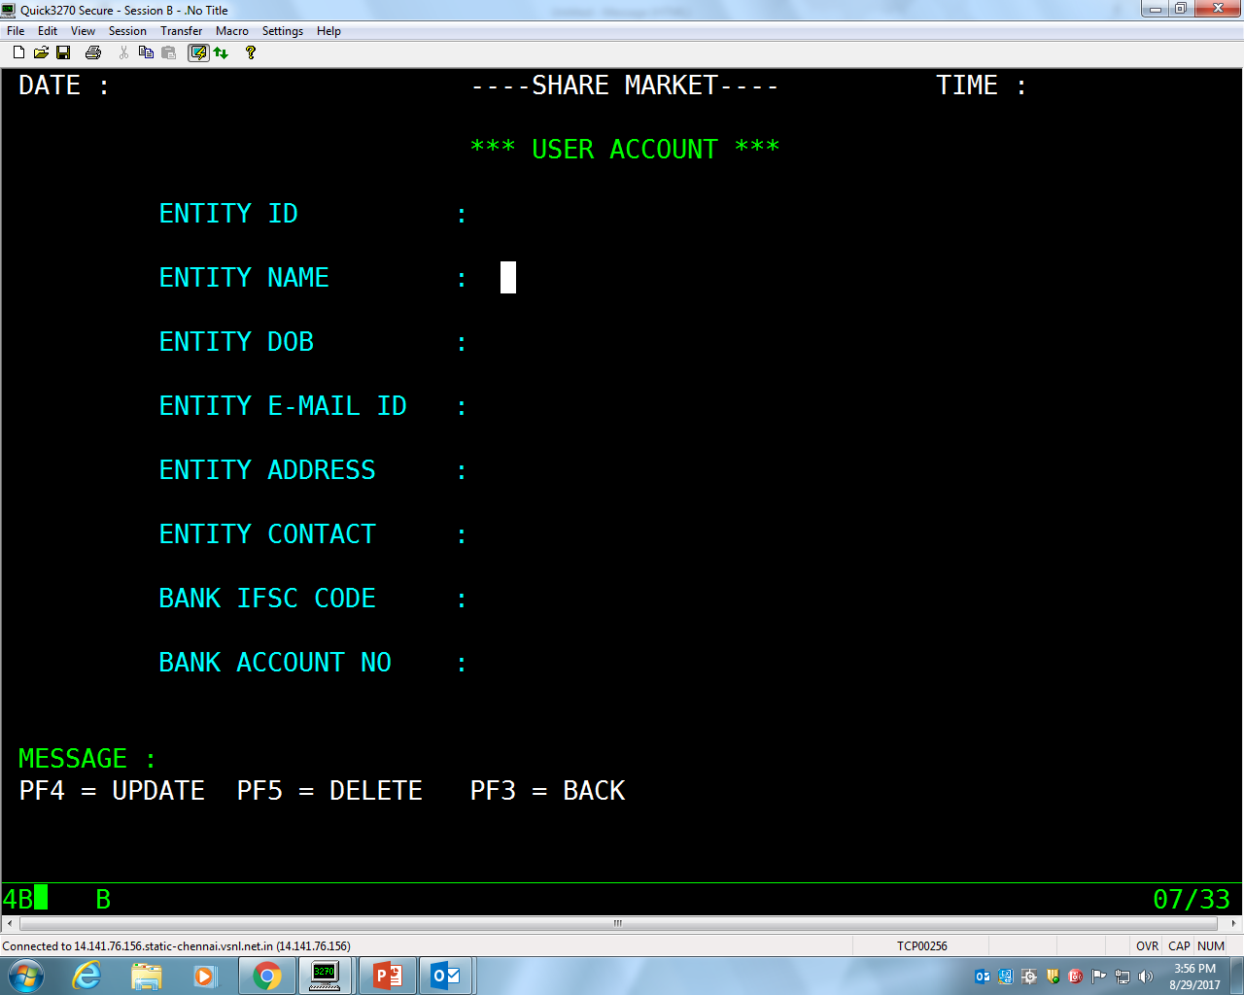
4. Account creation for entity

Slide 13
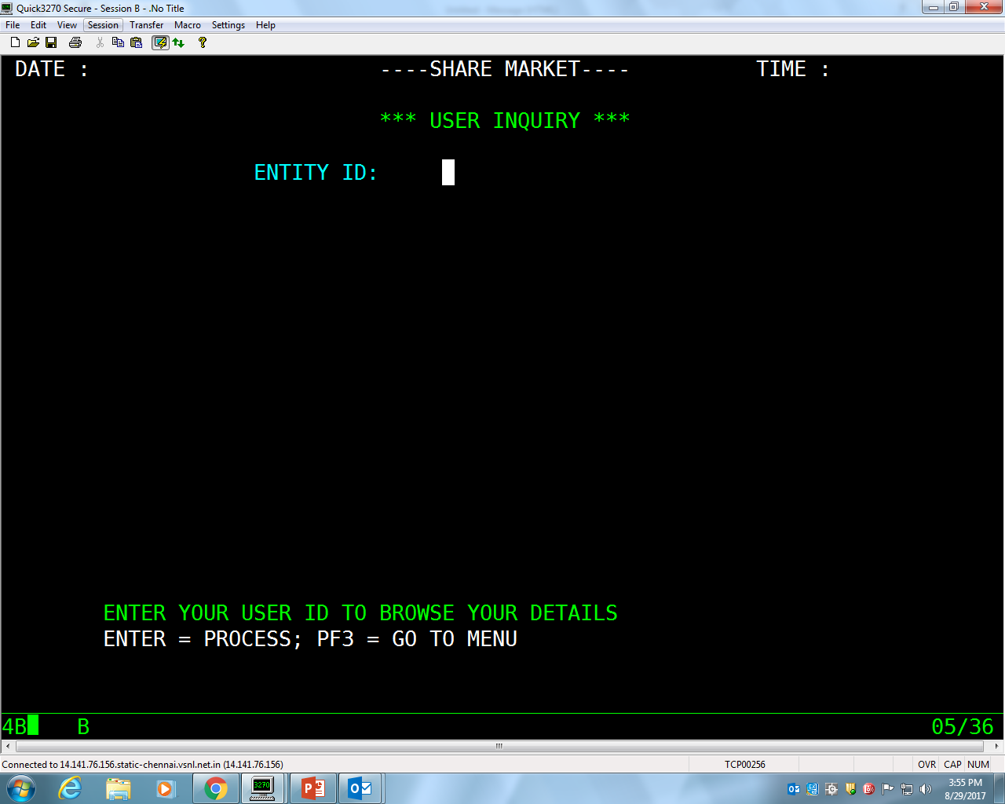
5. Inquiry for entity

Slide 14
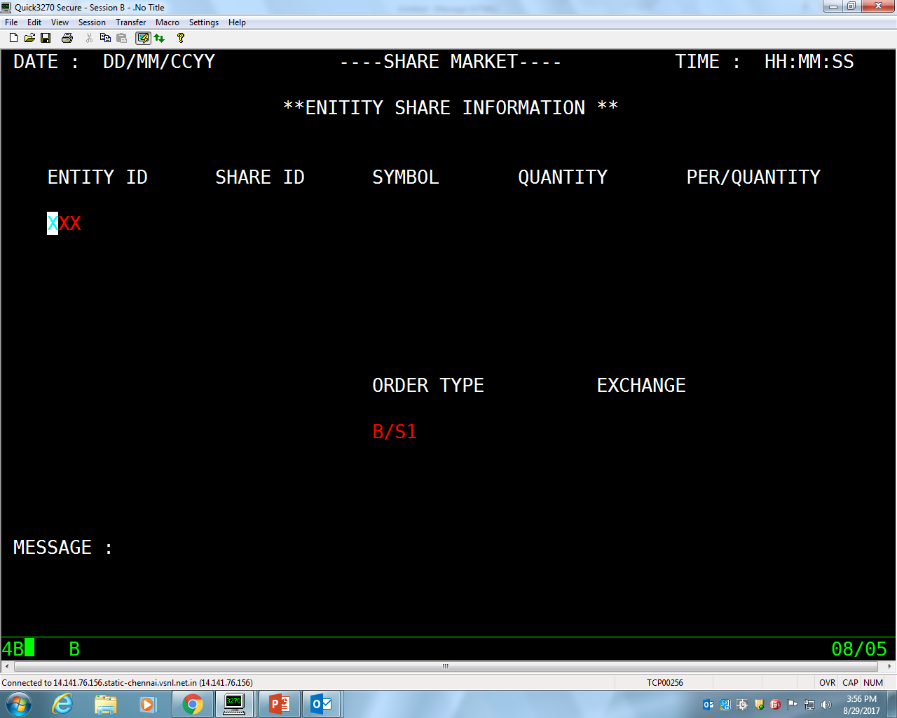
6. Entity SHARE INFORMATION

Slide 15



